Slide 1
Enrichment Programmes & Extra Curricular Activities 2023 - 2024
“
“A very high proportion of pupils involve themselves in one or more of the many sporting, musical and cultural opportunities offered by the school. As a result, these pupils participate fully in the life of the school.”
Ofsted 2018

Slide 2
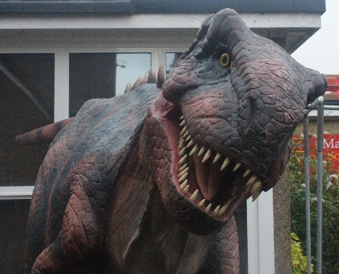
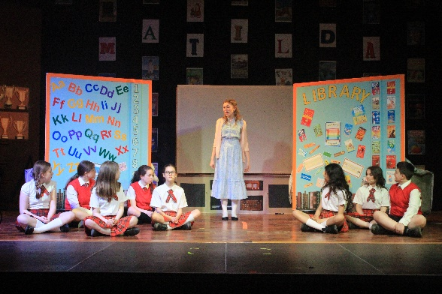
“
Here at Marlborough…
We offer our students an excellent range of extra-curricular activities and enrichment programmes. As part of our enrichment programme, we offer the following trips and workshops throughout the academic year, some of which are subject linked.
Year 7 Cinderella Pantomime – English Snow White - English Explorer Domes – Science Herts & Essex Big Bang Fair – Maths / Science Harry Potter Studios – English Boulogne - MFL Greenwich Observatory – Maths Author Visits – LRC | Year 8 St Albans Through Time – History Explorer Domes – Science Greenwich Observatory – Maths STEM Discovery Centre – Science Work Shadowing Day – PSHCEE Aladdin – English Author Visits – LRC Apprenticeship, Careers and Higher Education Fair – PSHCEE | Year 9 Cadbury World – Business Studies St Albans Through Time – History Kew Gardens – Art London Central Mosque / St Paul’s Cathedral – Philosophy and Ethics Cadets Winter Camp - CCF Inspector Calls Theatre – English Stitch Festival – D & T Stratford Olympic Park – Geography Sister Act Theatre – P&E

Slide 3
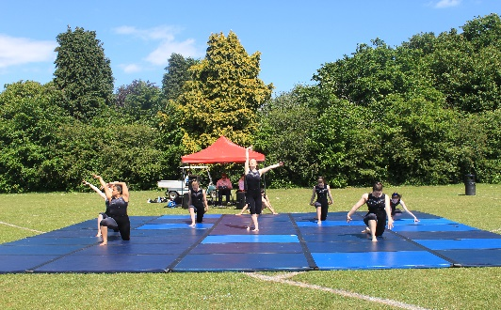
“
Here at Marlborough…
We offer our students an excellent range of extra-curricular activities and enrichment programmes. As part of our enrichment programme, we offer the following trips and workshops throughout the academic year, some of which are subject linked.
Year 10 The Henry Moore Foundation – Art Cadbury World – Business Studies London Central Mosque / St Paul’s Cathedral – Philosophy and Ethics Cadets Winter Camp (CCF) And then there were none– English Walton on the Naze – Geography Tate Modern – Art Sister Act Theatre – P&E What university & what career? - PSHCEE | Year 11 London Central Mosque / St Paul’s Cathedral – Philosophy and Ethics Cadets Winter Camp (CCF) Walton on the Naze – Geography Sister Act Theatre – P&E School Aerospace Careers – Maths Science Museum – Computer Science A Christmas Carol Theatre – English Tutor2U workshop – Business Studies New Designers – D & T | Year 12 Cadets Winter Camp (CCF) Science Museum – Computer Science Parliament and Supreme Court – Politics National Portrait Gallery – Art Tottenham Hotspur Stadium: Careers, University & Apprenticeship Fair – PSHCEE Work Experience – PSHCEE Curwen Print – Art Photographer Gallery – Photography Kings Cross – Geography London Docklands - Geography Alton Towers – Business Studies New Designers – D & T St Albans Study - Geography | Year 13 Cadets Winter Camp (CCF) Science Museum – Computer Science Parliament and Supreme Court – Politics National Portrait Gallery – Art Curwen Print – Art Photographer Gallery - Photography
Throughout the year we offer many Game Changer days across the curriculum. Details of these will be given to students by the subject teacher.

Slide 4
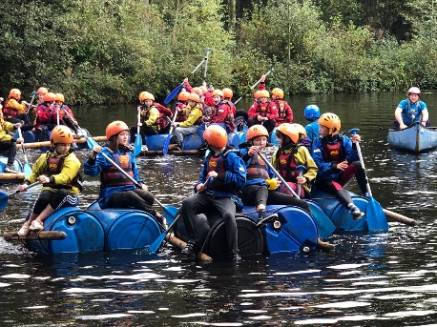
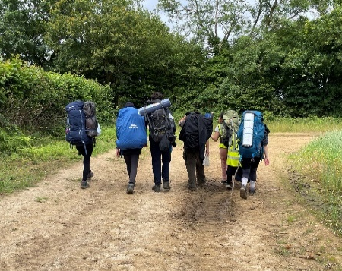
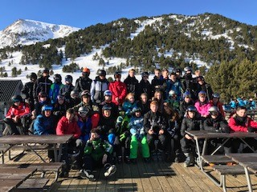
“
Also at Marlborough...
We offer our students a vast range of enrichment residential trips. Please find below what we are offering for each year group this academic year.
Year 7 PGL \ | Year 8 France – Disney (MFL) | Year 9 Ypres Battlefields (History) Cadet Autumn Camp (CCF) Duke of Edinburgh Award – Bronze Rome (P&E) Ski Trip (PE) Normandy France – MFL Cadet Summer Camp (CCF) | Year 10 Ypres Battlefields (History) Cadet Autumn Camp (CCF) Rome (P&E) Rome & Bay of Naples (Classics) Ski Trip (PE) Normandy France – MFL Andalucía (MFL) Cadet Summer Camp (CCF) | Year 11 Cadet Autumn Camp (CCF) Rome (P&E) Rome & Bay of Naples (Classics) Normandy France – MFL Andalucía (MFL) Cadet Summer Camp (CCF) | Year 12 Cadet Autumn Camp (CCF) Rome & Bay of Naples (Classics & P&E) Cadet Summer Camp (CCF) | Year 13 Cadet Autumn Camp (CCF) Rome & Bay of Naples (Classics & P&E) Cadet Summer Camp (CCF)
Some of the above trips will be subject linked. Details of these trips will be given to the students by the subject teacher.
“Pupils enjoy coming to school because, as one put it, teachers always go the extra mile to help us, and there is so much to get involved in outside of our lessons.”
Ofsted 2018

Slide 5
We offer our students an excellent range of extra-curricular activities and enrichment programmes. Please find details on the follow pages of clubs that take place at Marlborough. On MONDAY, the following clubs are running;
Additionally at Marlborough…
Key Information: We offer instrumental and vocal teaching including; guitar, saxophone, piano, voice, brass, woodwind, strings, percussion and music theory. The School newspaper is “The MO”, if you would like to be a reporter or editor for the paper, please contact Ms Redfern. Year 12 & 13. PE Clubs can change half termly – please check the timetable in the PE corridor. Breakfast Club Canteen, Mrs Mitchell & Miss Begum 8:00am – 8:25am All Years Touch Typing Brooks Suite, Specialised Learning Staff 8:40am – 8:55am Invited Students | Before School Activities | Lunchtime Activities | After School Activities
 | IDA Brooks Suite, Specialised Learning Staff 8:40am – 8:55am Invited Students Handwriting Brooks Suite, Specialised Learning Staff 8:40am – 9:00am Invited Students Design & Build Workshop B7, Mr Dwane / Mr Green 1:30pm- 2:05pm Year 7 & 8 Piano Lessons ( Beginner) M1, Ms Conwell 1:30pm- 2:00pm All Years GCSE Graphics Catch Up B2, Mr Cockram 1:30pm- 2:00pm Year 9- 11 Dungeons & Dragons A3, Mr Dean 1:30pm- 2:00pm All Years | Prayer Room The Marlborough Suite, Mrs Begum / Mr Rahman 1:30pm- 2:05pm All Years GCSE Art Catch Up D4, Mrs Punio 1:20pm- 2:00pm Year 9, 10 & 11 Culture Club S7, Mrs Claridge 1:35pm- 2:05pm Year 7 & 8 Movie Mondays: History A4, Miss King 1:30pm- 2:05pm All Years Tudor Revision A7, Mr Pressland 1:35pm- 2:10pm Year 13 Puzzles & Board Games LRC, Mrs Wood / Mrs Nixon 1:20pm- 2:10pm All Years Table Tennis Sports Hall, Mr Hodge 1:30pm- 2:00pm All Years | Latin Club (Intermediate) A5, Miss Rowe 3:20pm – 4:20pm Year 9 (invite only) Home Learning LRC, Specialised Learning Staff 3:10pm – 4:10pm All Years Advanced Swimming Pool, Mrs Eaton 3:10pm – 4:00pm All Years
Lunchtime Activities
Before School Activities

Slide 6
On TUESDAY, the following clubs are running;
“
Key Information: We offer instrumental and vocal teaching including; guitar, saxophone, piano, voice, brass, woodwind, strings, percussion and music theory. The School newspaper is “The MO”, if you would like to be a reporter or editor for the paper, please contact Ms Redfern. Year 12 & 13. PE Clubs can change half termly – please check the timetable in the PE corridor. | Before School Activities | Lunchtime Activities | After School Activities
 | Breakfast Club Canteen, Mrs Mitchell & Miss Begum 8:00am – 8:25am All Years Handwriting Brooks, Specialised Learning Staff 8:30am – 8:55am Invited Students Touch Typing Brooks, Specialised Learning Staff 8:40am – 8:55am Invited Students | Textiles B4, Mrs Smead / Ms Allard 1:25pm – 2:00pm Year 7, 8 & 9 Prayer Room The Marlborough Suite, Mrs Begum / Mr Rahman 1:30pm- 2:05pm All Years Exam Techniques A7, Mr Pressland 1:35pm – 2:10pm Year 13 Puzzles & Board Games LRC, Mrs Wood / Mrs Nixon 1:20pm- 2:10pm All Years Badminton Sports Hall, Mr Hodge 1:30pm – 2:00pm All Years Mixed Band M1, Mr Felkers 1:20pm – 2:10pm Year 9 & 10 | Home Learning LRC, Specialised Learning Staff 3:10pm – 4:10pm All Years School Production Rehearsals Da Vinci Hall, Mrs Griggs / Mr Griggs / Mrs Day / Mr Isaacs 3:30pm – 5:30pm Auditioned Students Social Skills Brooks Suite, Specialised Learning Staff 3:10pm – 4:10pm Year 9 Coding FB5, Mr Rahman / Mr Green 3:20pm – 4:20pm All Years Dance Gym, Miss Fox 3:10pm – 4:30pm Year 7 & 8 English Revision S1, Ms Jones 3:20pm – 4:20pm Year 11 – Invited Students | Twilight French P8, Mrs Short 3:15pm – 4:45pm Year 10 Duolingo P9, Mrs Jubb / Mrs Morrissey 3:15pm – 4:00pm Year 7 & 8 Basketball Sports Hall, Mr Vivian / Mr Hodge 3:20pm – 4:30pm Year 7 & 8 Boys Football Field, Mr Packard 3:20pm – 4:30pm Year 9 Girls Football Field, Miss Arrol 3:20pm – 4:30pm All Years Developmental Swimming Pool, Mrs Eaton 3:10pm – 4:00pm All Years

Slide 7
On WEDNESDAY, the following clubs are running;
“
Key Information: We offer instrumental and vocal teaching including; guitar, saxophone, piano, voice, brass, woodwind, strings, percussion and music theory. The School newspaper is “The MO”, if you would like to be a reporter or editor for the paper, please contact Ms Redfern. Year 12 & 13. PE Clubs can change half termly – please check the timetable in the PE corridor. Breakfast Club Canteen, Mrs Mitchell & Miss Begum 8:00am – 8:25am All Years Touch Typing Brooks Suite, Specialised Learning Staff 8:40am – 8:55am Invited Students IDA Brooks Suite, Specialised Learning Staff 8:40am – 8:55am Invited Students Handwriting Brooks Suite, Specialised Learning Staff 8:40am – 9:00am Invited Students | Lunchtime Activities | After School Activities
 | Prayer Room The Marlborough Suite, Mrs Begum/ Mr Rahman 1:30pm- 2:05pm All Years The Great British Cake Off A8, Miss Warr 1:20pm – 2:05pm All Years Starts 27th September Heritage Club A7, Mr Pressland 1:35pm – 2:10pm All Years Cold War Revision A4, Miss King 1:30pm – 2:00pm Year 12 & 13 Puzzles & Board Games LRC, Mrs Wood / Mrs Nixon 1:20pm- 2:10pm All Years French Foundation Intervention P9, Mrs Jubb 1:20pm – 2:00pm Year 11 Spanish Foundation Intervention P11, Mrs Morrissey 1:20pm – 2:00pm Year 11 Chess FB4, Mr Rahman / Mr Mudadigwa 1:30pm- 2:05pm All Years | Drama D1, Mrs Day / Mrs Baker 3:20pm – 4:30pm All Years Home Learning LRC, Specialised Learning Staff 3:10pm – 4:10pm All Years Study Hub Brooks Suite, Specialised Learning Staff 3:10pm – 4:10pm Year 10 & 11 English Revision S3, Ms Mitchell 3:20pm – 4:20pm Year 11 – Invited Students History Exam Support A4 / A7, Miss King / Mr Pressland 3:15pm – 4:00pm Year 11 Home Learning LRC, Specialised Learning Staff 3:10pm – 4:10pm All Years STEM Science Club F3, Miss O’Krafka / Mrs Leinster 3:10pm – 4:10pm Year 8 & 9 Acro Gymnastics Gym, Miss Eastwood 3:20pm – 4:20pm All Years | GCSE Trampolining Sports Hall, Mr Vivian 3:10pm – 4:30pm Year 9, 10 & 11 – Invited Students KS3 Netball Courts, Mrs Eaton / Miss Fox 3:10pm – 4:30pm Year 7 & 8 Boys Football Field, Mr Hodge / Mr Dean 3:20pm – 4:30pm Year 7 & 8
Lego Lab
LRC, Mrs Wood / Mrs Nixon
1:20pm- 2:10pm
Year 7 & 8
Band
M1, Mr Felkers
1:20pm- 2:10pm
Year 10
Before School Activities

Slide 8
On THURSDAY, the following clubs are running;
“
Key Information: We offer instrumental and vocal teaching every day including; guitar, saxophone, piano, voice, brass, woodwind, strings, percussion and music theory. The School newspaper is “The MO”, if you would like to be a reporter or editor for the paper, please contact Ms Redfern. Year 12 & 13. PE Clubs can change half termly – please check the timetable in the PE corridor. Breakfast Club Canteen, Mrs Mitchell & Mrs Begum 8:00am – 8:25am All Years | Lunchtime Activities |  | After School Activities
 | GCSE Art Catch Up D6, Ms Bustin 1:20pm- 2:00pm Year 9 & 10 Art Club D4, Mrs Punio 1:20pm- 2:10pm All Years Prayer Room The Marlborough Suite, Mrs Begum/ Mr Rahman 1:30pm- 2:05pm All Years True Crime S5, Miss Fogarty 1:30pm- 2:05pm Year 11 Creative Writing S8, Miss Caswell 1:30pm- 2:10pm All Years Puzzles & Board Games LRC, Mrs Wood / Mrs Nixon 1:20pm- 2:10pm All Years History Buffs Exam Aid Squad A4, Miss King 1:30pm- 2:00pm Year 10 – Invited Students | Thriving Thursday LRC, Mrs Wood 1:20pm – 2:10pm All Years Classics A5, Miss Rowe 1:30pm- 2:10pm All Years Wind Band M1, Mr Felkers 1:20pm- 2:10pm All Years Water Polo Pool, Mr Hodge 1:20pm- 2:10pm All Years | School Production Rehearsals Da Vinci Hall, Mrs Griggs / Mr Griggs / Mrs Day / Mr Isaacs 3:30pm – 5:30pm Auditioned Students Study Hub Brooks Suite, Specialised Learning Staff 3:10pm – 4:10pm Year 9, 10 & 11 Latin Club (Beginners) A5, Miss Rowe 3:15pm – 4:00pm All Years Twilight GCSE Dance Gym, Miss Fox 3:20pm – 4:45pm Year 9 & 10 Book Club LRC, Mrs Nixon 3:10pm – 4:10pm All Years Home Learning LRC, Specialised Learning Staff 3:10pm – 4:10pm All Years Twilight French P10, Mr Henshall 3:15pm – 4:45pm Year 11 | Bridging to Higher Intervention - French P9, Mrs Jubb 3:15pm – 4:00pm Year 11 Science Club F2, Miss O’Krafka / Dr Szameitat 3:10pm – 4:10pm Year 7 Basketball Sports Hall, Mr Vivian / Mr Hodge 3:20pm – 4:30pm Year 10 KS4 & KS5 Netball Courts, Mrs Eaton / Miss Arrol 3:10pm – 4:30pm Year 9 – 13 Engineering Club B5, Mr Clark 3:15pm – 4:00pm All Years
Before School Activities

Slide 9
On FRIDAY, the following clubs are running;
“
Key Information: We offer instrumental and vocal teaching every day including; guitar, saxophone, piano, voice, brass, woodwind, strings, percussion and music theory. The School newspaper is “The MO”, if you would like to be a reporter or editor for the paper, please contact Ms Redfern in English. This is for Years 12 and 13. PE Clubs can change half termly – please check the timetable in the PE corridor. Breakfast Club Canteen, Mrs Mitchell & Miss Begum 8:00am – 8:25am All Years Touch Typing Brooks Suite, Specialised Learning Staff 8:40am – 8:55am Invited Students IDA Brooks Suite, Specialised Learning Staff 8:40am – 8:55am Invited Students | Lunchtime Activities |  | After School Activities
 | Prayer Room The Marlborough Suite, Mrs Begum/ Mr Rahman 1:30pm- 2:05pm All Years Minecraft FB3, Mr Rutherford 1:30pm – 2:05pm Year 7 & 8 Anime S3, Ms Mitchell 1:30pm – 2:00pm All Years Volleyball Sports Hall, Miss Arrol 1:30pm – 2:00pm All Years Explore A8, Explore & Miss Warr 1:20pm – 2:10pm All Years Puzzles & Board Games LRC, Mrs Wood / Mrs Nixon 1:20pm- 2:10pm All Years Arts & Crafts LRC, Mrs Wood 1:20pm- 2:10pm All Years | Engineering Catch Up B1, Miss May 1:20pm- 2:00pm Year 10 & 11 | Home Learning LRC, Specialised Learning Staff 3:10pm – 4:10pm All Years Penmanship S7, Mrs Claridge 3:15pm – 3:45pm Year 7 & 8 - Invited Students CCF Cadets St Albans School, Ms Kelly 3:20pm – 6:00pm Year 9 – 13
Before School Activities
“You have been successful in your determination to create a community in which there is always someone to help, to support and to inspire.” Ofsted 2018

