Slide 1
Sparx Instructions

Slide 2
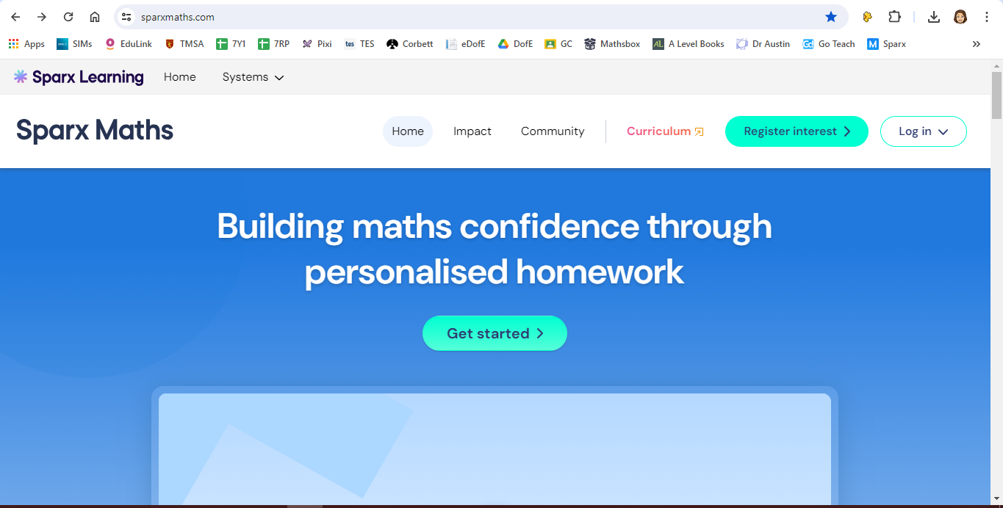
Go to: sparxmaths.com

Slide 3
Click on Log in

Slide 4
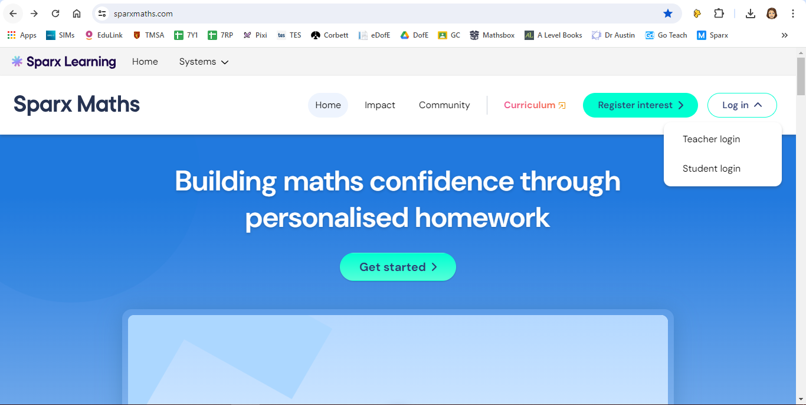
Click on student login

Slide 5
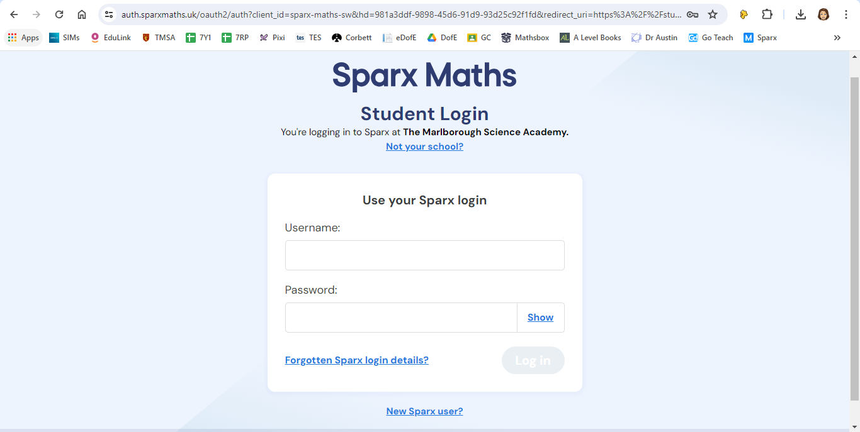
Click on New Sparx user

Slide 6
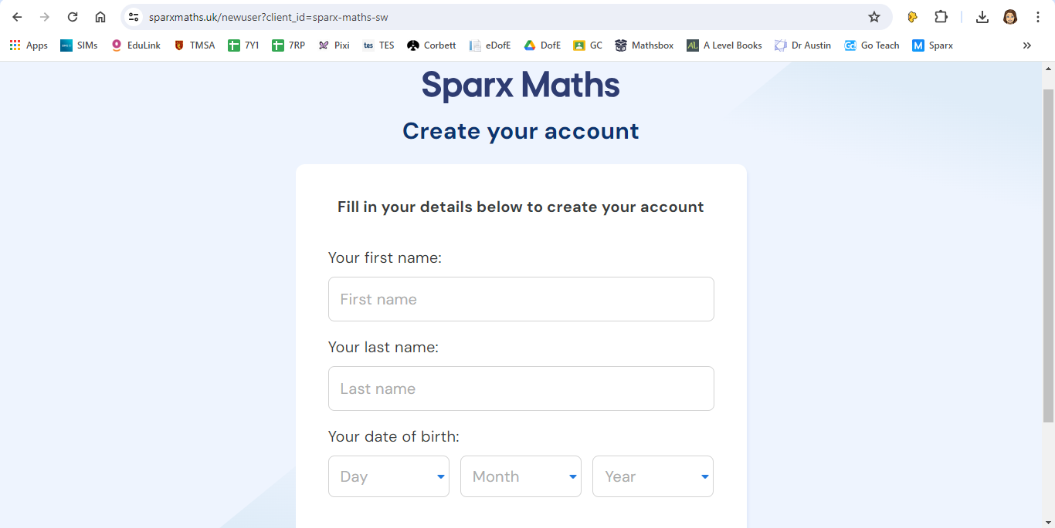
Fill in your details

Slide 7
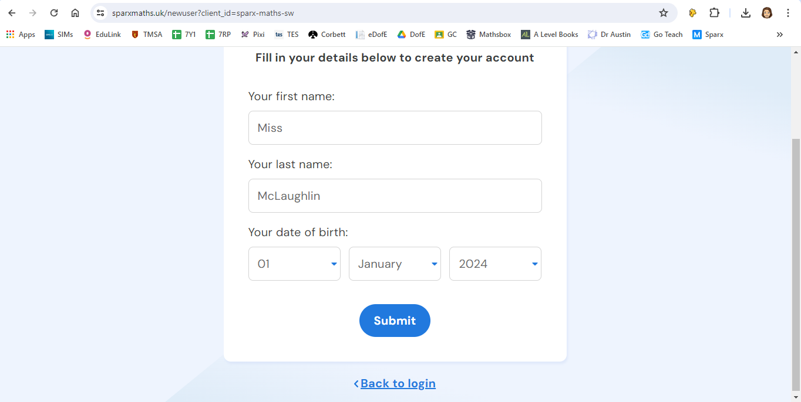
Scroll down and click submit

